Slide 1

Electronics Lab (Experiment-3)
C. Pranav Vignesh Roll no : 21IE10011
P . Manoj Kumar Roll no : 21IE10027
Bibhujit Nayak Roll no : 21IE10046

Slide 2
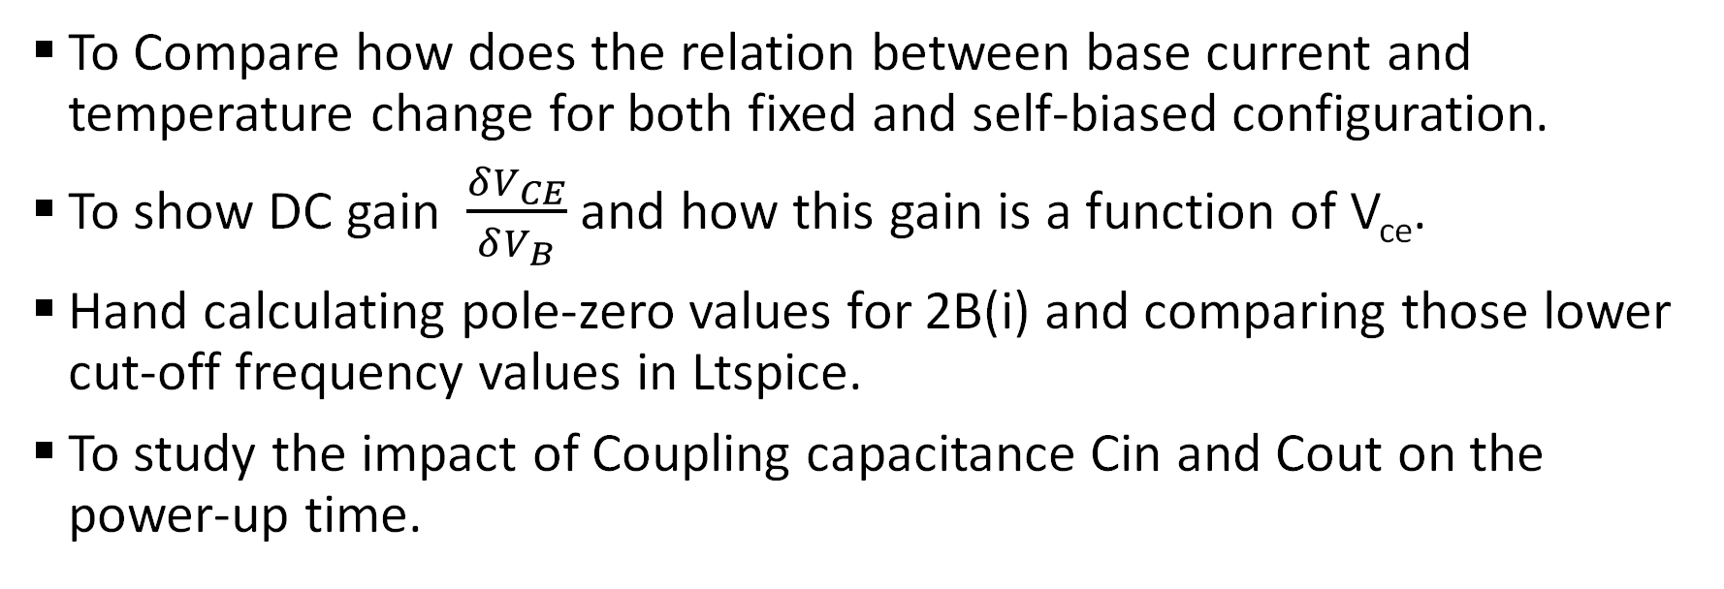
Objective of the Experiment
To Compare how does the relation between base current and temperature change for both fixed and self-biased configuration.
To show DC gain $\frac{δV_{CE}}{δV_{B}}$and how this gain is a function of V_{ce}.
Hand calculating pole-zero values for 2B(i) and comparing those lower cut-off frequency values in Ltspice.
To study the impact of Coupling capacitance Cin and Cout on the power-up time.

Slide 3
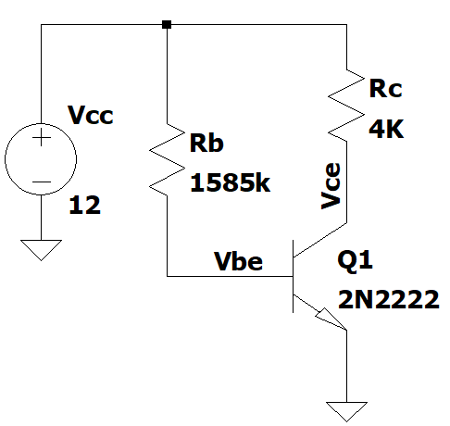
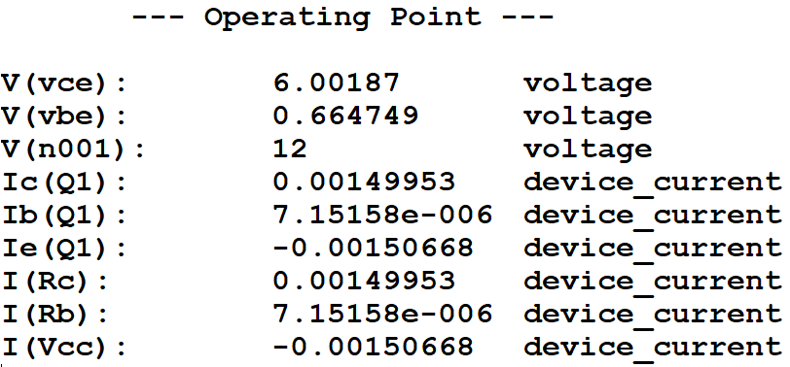
1.Circuit Diagram-I
Fig-1.1-Circuit Diagram and DC operating point analysis of a fixed bias common emitter configuration having only one resistance at base.

Slide 4
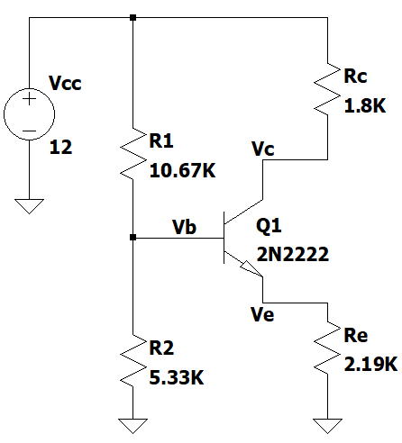
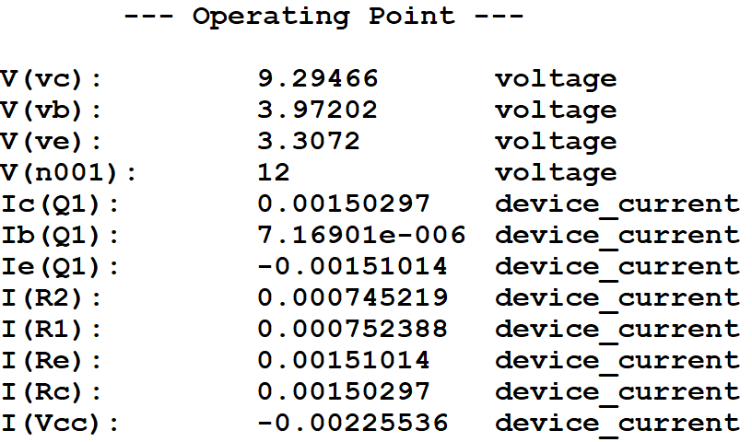
Circuit Diagram-II
Fig-1.2-Circuit Diagram and DC operating point analysis of a self bias common emitter configuration having emitter degeneration.

Slide 5
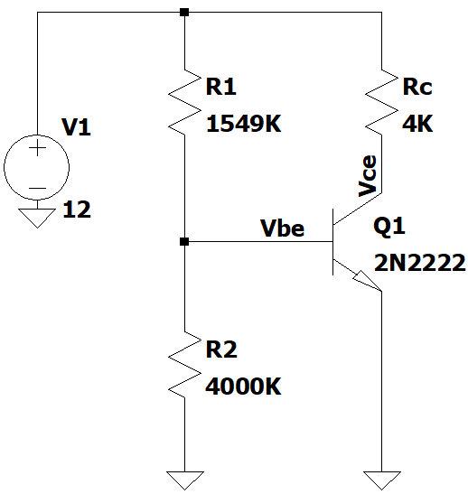
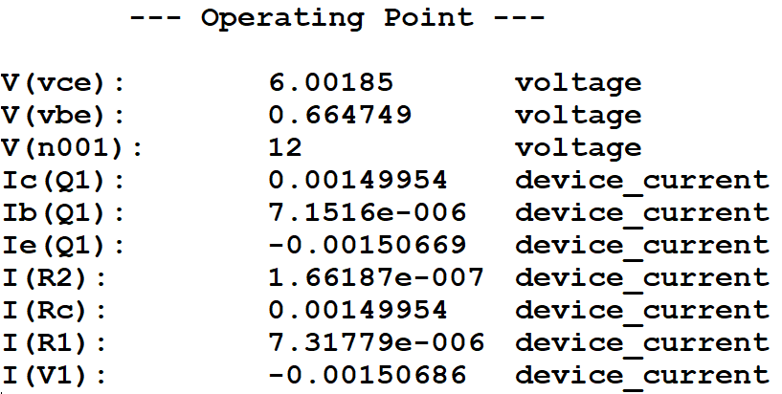
Circuit Diagram-III
Fig-1.3-Circuit Diagram and DC operating point analysis of a self bias common emitter configuration without having emitter degeneration.

Slide 6
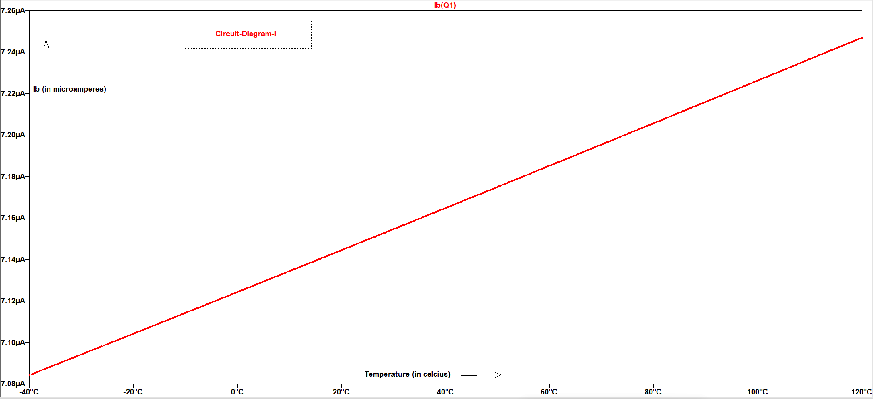
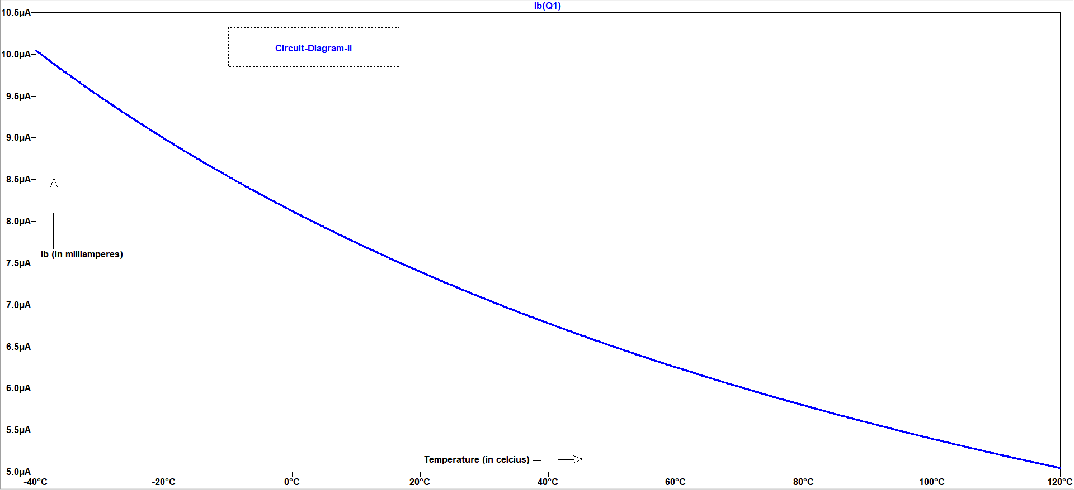
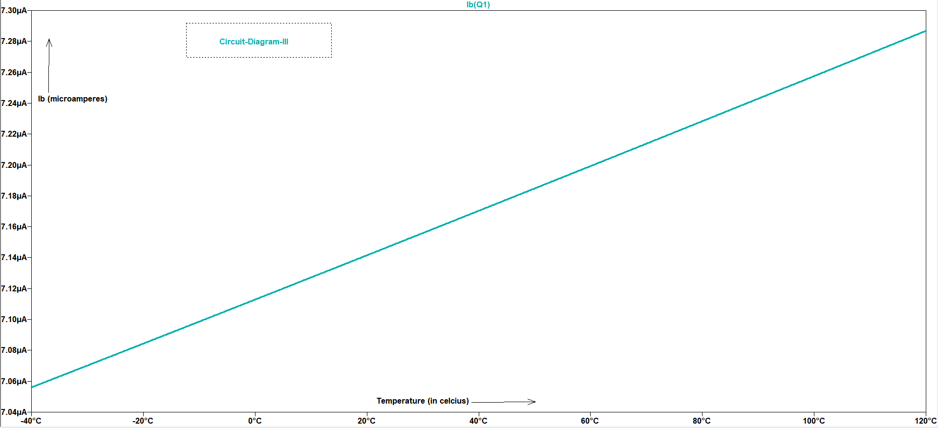
Variation of base current with temperature
Fig-1.4- I_{b} vs temperature plot for the
three configurations

Slide 7



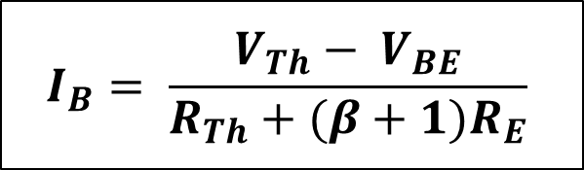
Calculations
1. For fixed bias, $V_{cc}− I_{B}R_{B}= V_{BE}$
2. For Self bias configuration With R_{E} ,
$V_{cc}− I_{c}R_{c}−V_{CE}−I_{E}R_{E}=0$
$V_{Th}− I_{B}R_{Th}−V_{BE}−I_{E}R_{E}=0$ ,
where$V_{Th}=V_{cc}(\frac{R_{2}}{R_{1}+R_{2}})$ , $R_{Th}= R_{1}||R_{2}$
3. For Self bias Configuration without R_{E} ,
$$I_{B}= \frac{V_{cc}−V_{BE}}{R_{B}}$$
$$I_{B}= \frac{V_{Th}− V_{BE}}{R_{Th}+(β+1)R_{E}}$$
$$I_{B}= \frac{V_{Th}− V_{BE}}{R_{Th}}$$

Slide 8
Variation of base current with temperature
In fixed bias configuration and self-bias configuration without R_{E} ,the increase in temperature causes an increase in the intrinsic carrier concentration leading to a corresponding increase in the base current. There is a decrease in the base-emitter voltage.
The presence of RE in a self-biased common emitter amplifier stabilizes the operating point, leading to a decrease in Ib with an increase in temperature.
However, when RE is removed, there is no stabilization, leading to an increase in Ib with an increase in temperature.

Slide 9

2-Circuit Diagram and DC-Gain-I
Fig-2.1-Circuit Diagram and DC gain of Common emitter amplifier in fixed bias configuration
$$V_{cc}− I_{B}R_{B}= V_{BE}⇒V_{cc}−V_{BE}=I_{B}R_{B}$$
$$V_{cc}− I_{c}R_{c}= V_{CE}⇒V_{cc}−V_{CE}=I_{c}R_{c}={βI}_{B}R_{c}$$
$$V_{cc}−V_{CE}={\frac{{βR}_{c}}{R_{b}}(V}_{cc}−V_{BE})$$
$$\frac{δV_{CE}}{δV_{B}}=\frac{{βR}_{c}}{R_{b}}=\frac{V_{cc}−V_{CE}}{I_{B}R_{B}}$$

Slide 10

Circuit Diagram and DC-Gain-II
Fig-2.2-Circuit Diagram and DC gain of Common emitter amplifier in self bias configuration
$$V_{cc}− I_{c}R_{c}− V_{CE}−I_{E}R_{E}=0$$
$$⇒V_{cc}− V_{CE}=({βR}_{c}+\left({β+1)R}_{E}\right)I_{B}$$
$$V_{Th}− I_{B}R_{Th}− V_{BE}−I_{E}R_{E}=0⇒V_{Th}− I_{B}R_{Th}− V_{B}=0$$
$$⇒V_{Th}− V_{B}=I_{B}R_{Th}= \frac{V_{cc}− V_{CE}}{({βR}_{c}+\left({β+1)R}_{E}\right)} R_{Th}$$
$$\frac{δV_{CE}}{δV_{B}}=\frac{{βR}_{c}+\left({β+1)R}_{E}\right)}{R_{Th}}=\frac{V_{cc}−V_{CE}}{I_{B}R_{Th}}$$

Slide 11
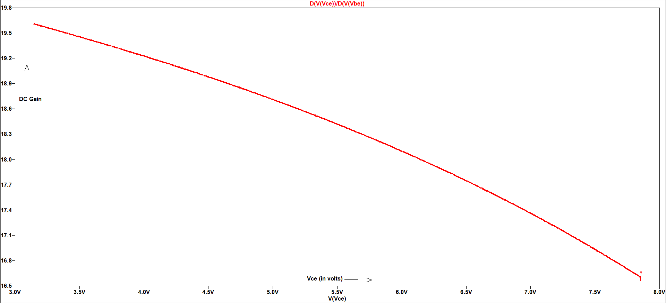
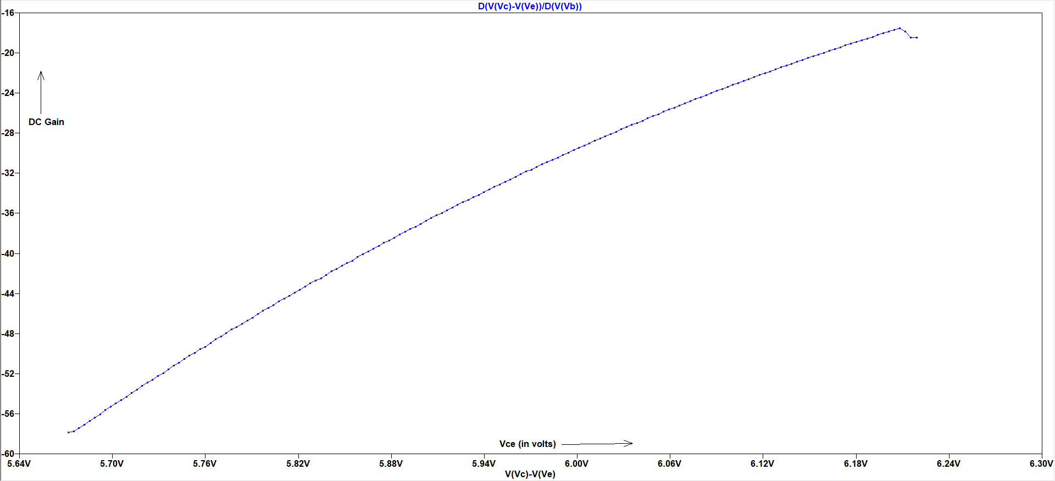
DC gain vs Vce plot
Fig-2.3-DC gain vs V_{ce} plot for fixed bias configuration Fig-2.4-DC gain vs V_{ce} plot for self bias configuration with R_{E}
The base current increases in self bias with increase in temperature, so there is an decrease in gain.
The base current decreases in self bias with increase in temperature, so there is an increase in gain.

Slide 12
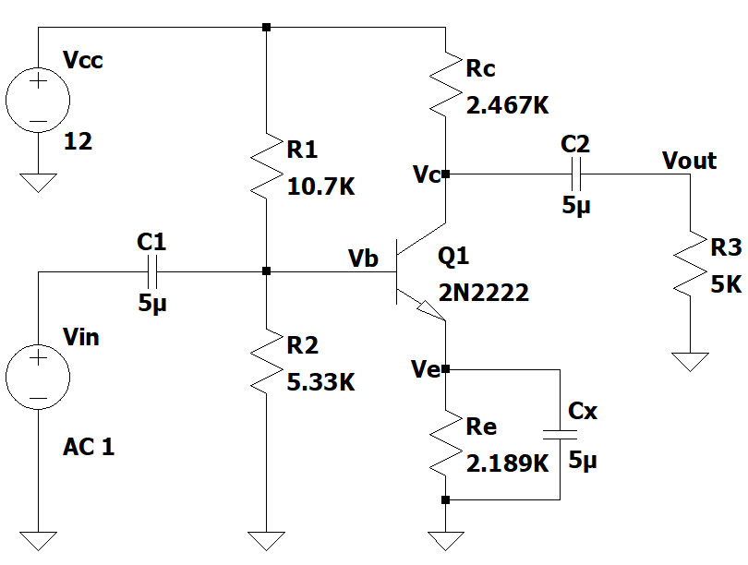
3-Circuit Diagram
Fig-2.1-Circuit Diagram of Common emitter amplifier with coupling capacitances and load

Slide 13
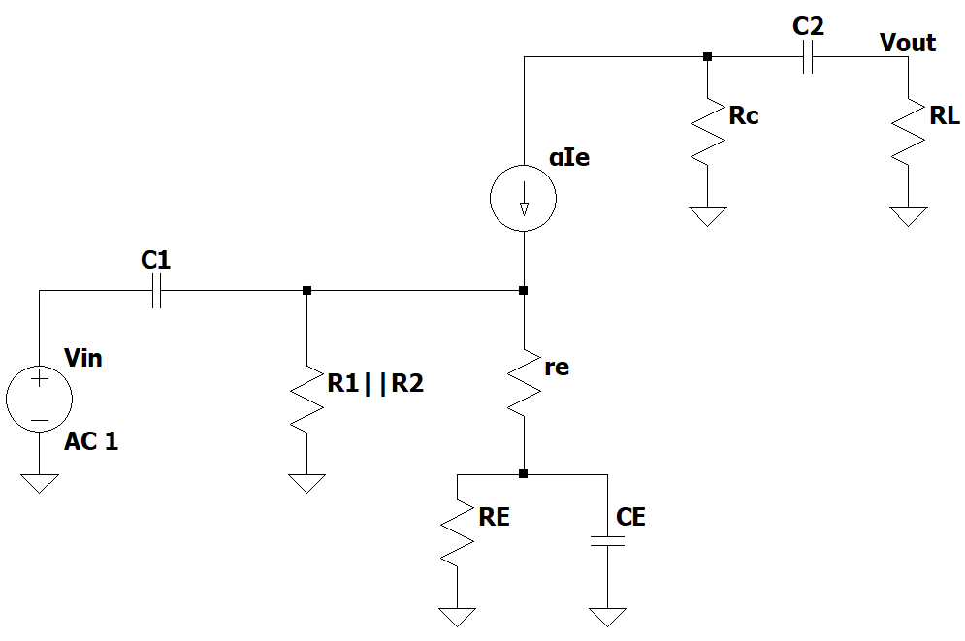
Small Signal model of the CE Amplifier
Fig-3.2-Small signal model (T-model) of the Common emitter amplifier

Slide 14
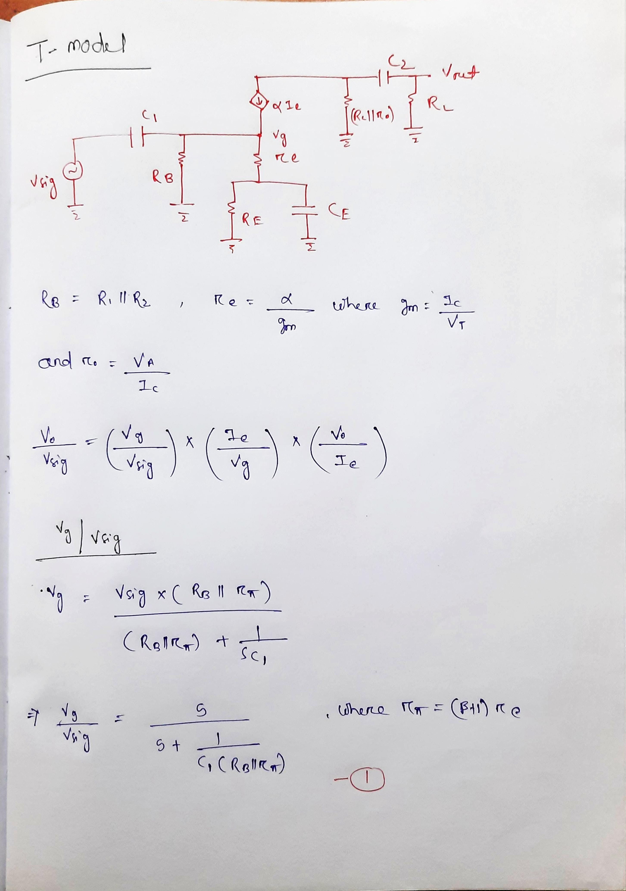
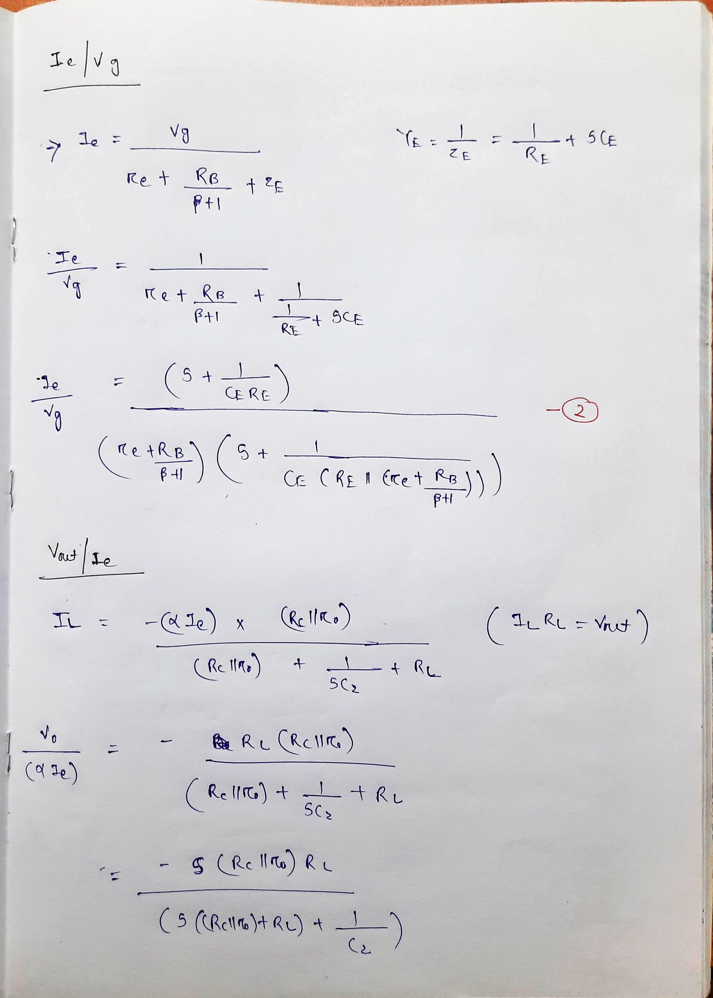
Hand Calculation

Slide 15
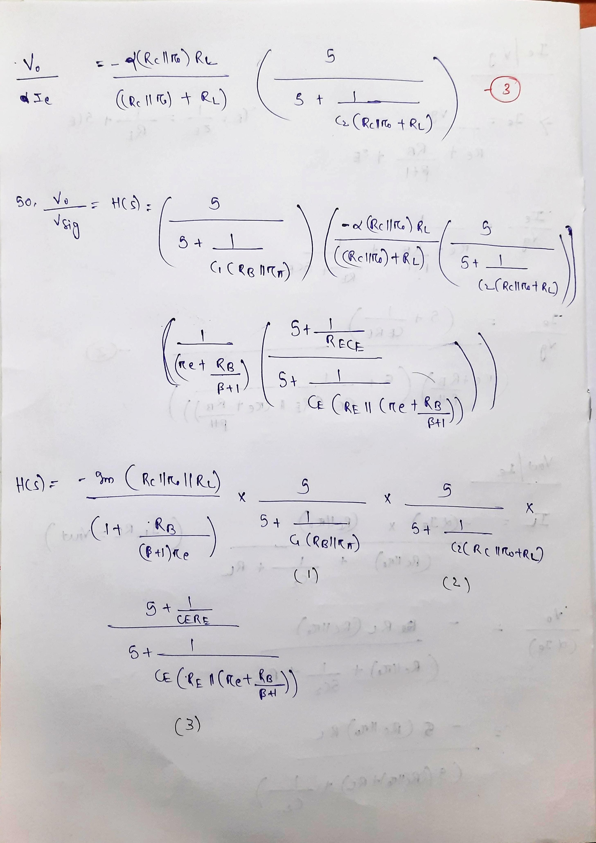
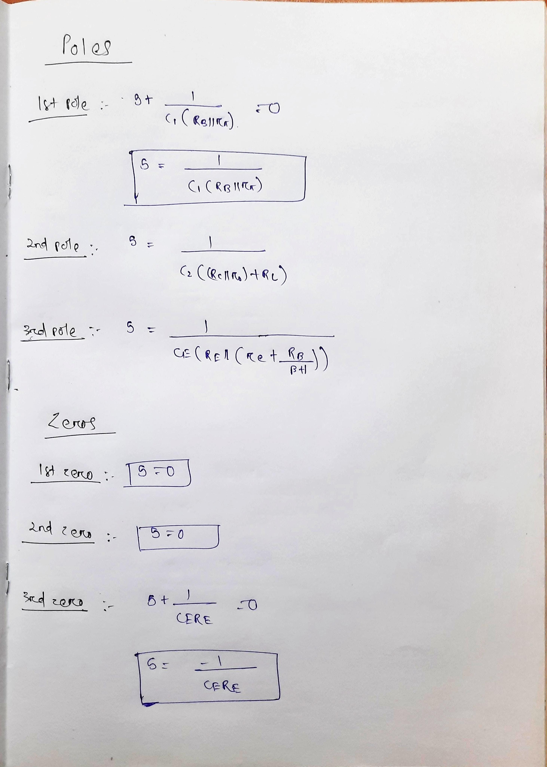
Hand Calculation

Slide 16
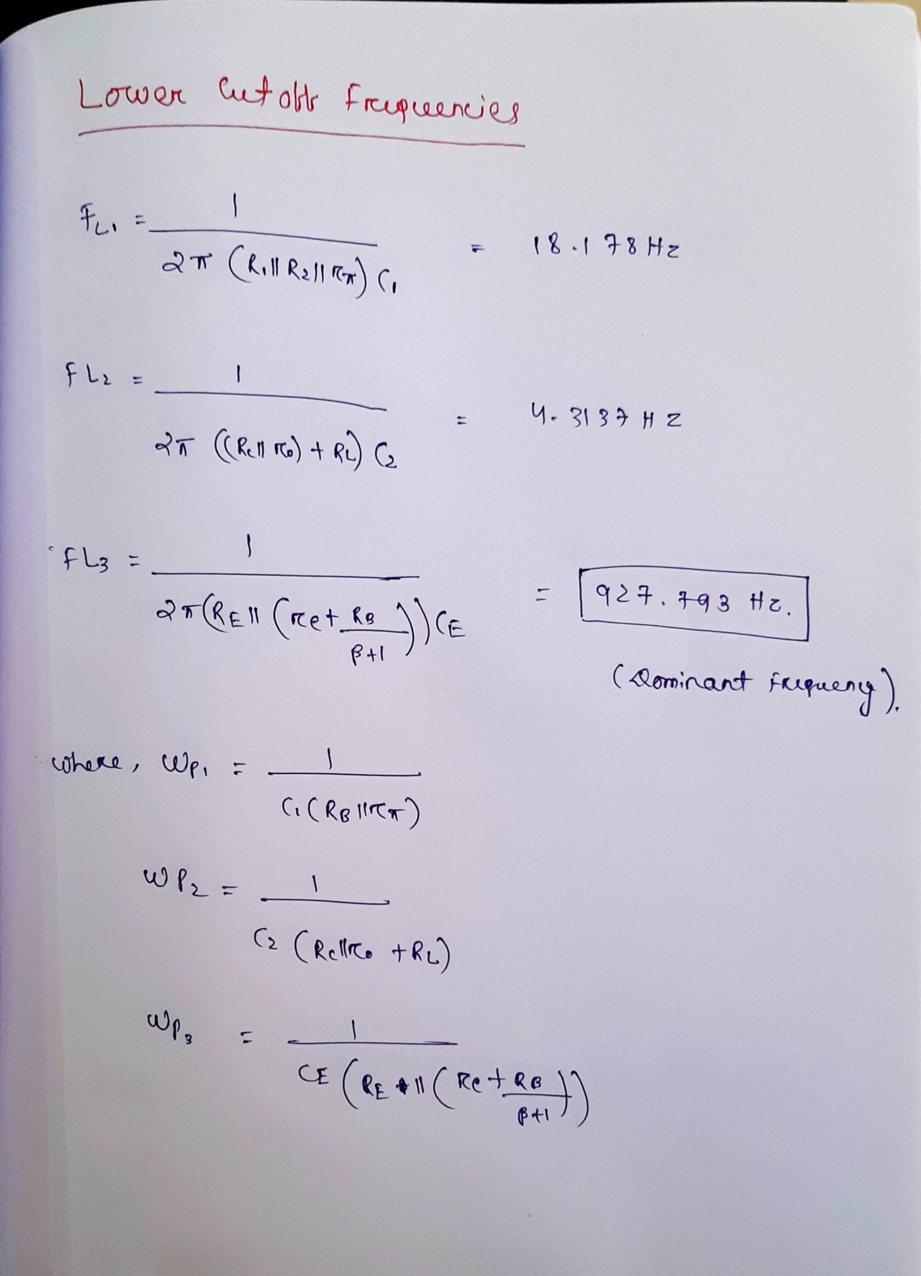
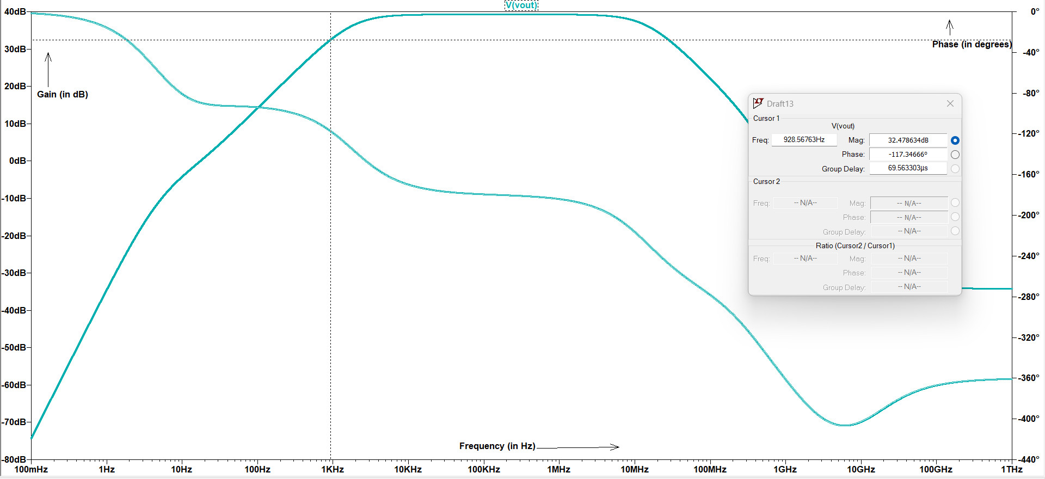
Hand Calculation( Lower Cut-off Frequencies
Fig-3.3-Calculation Of poles

Slide 17
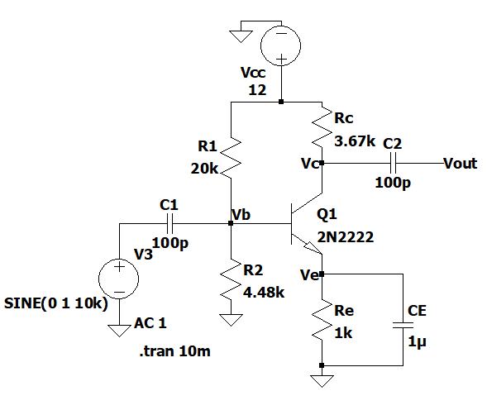
4-Circuit Diagram
Fig-2.1-Circuit Diagram of Common emitter amplifier with coupling capacitances and load

Slide 18
Theory :-
Power-up Time - The power-up time of the amplifier refers to the time it takes for the amplifier to stabilize and reach a steady-state operating condition.
To calculate the power-up time from the graph, you need to determine the time it takes for the output voltage to reach a certain percentage of its steady-state value.
Coupling capacitors, C_{in} and C_{out}, play an important role in the operation of the common emitter amplifier.
Cin is the input coupling capacitor which blocks any DC voltage at the input from reaching the amplifier, while allowing the AC signal to pass through.
Cout is the output coupling capacitor which blocks any DC voltage at the output from reaching the load, while allowing the AC signal to pass through.

Slide 19
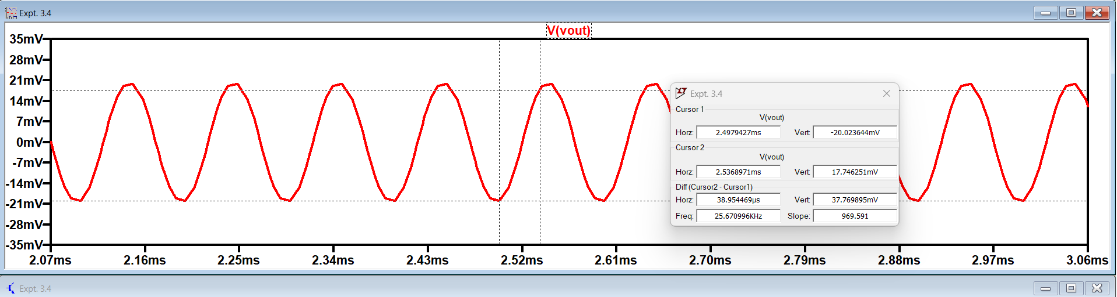
For C1 = C2 = 1pF
Ltspice Simulation
Vout(in mV) -->
Time(in ms) -->
Power-up Time = 38.954469us
A lower value of capacitance will result in a shorter time constant, and a shorter power-up time.

Slide 20
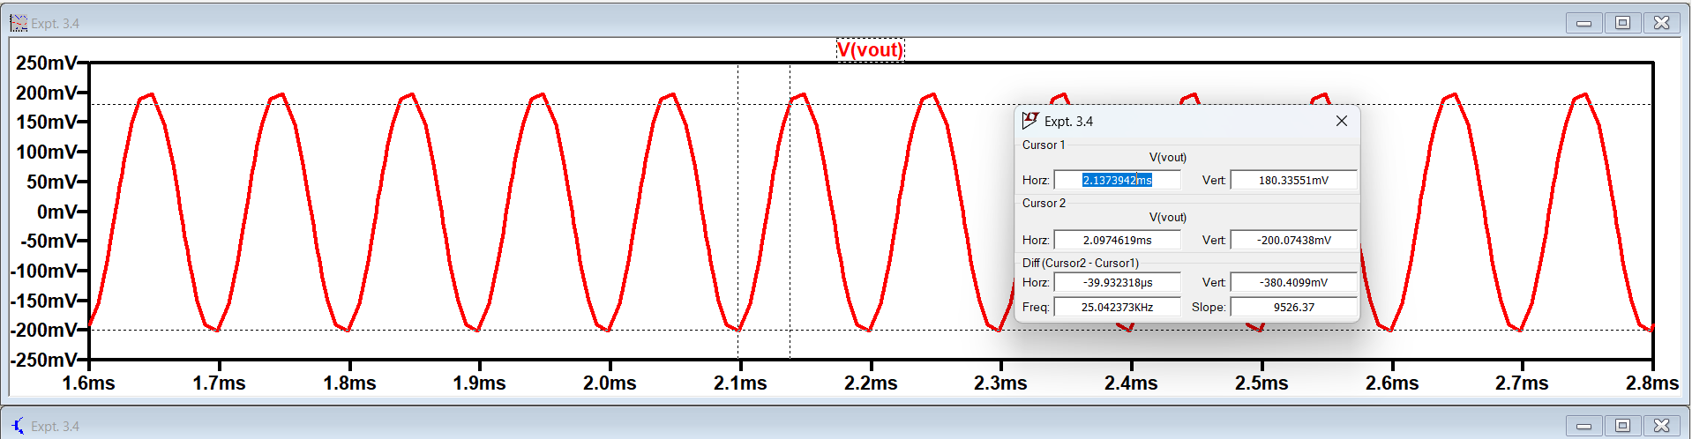
For C1 = C2 = 10pF
Ltspice Simulation
Vout(in mV) -->
Time(in ms) -->
Power-up Time = 39.9323us

Slide 21
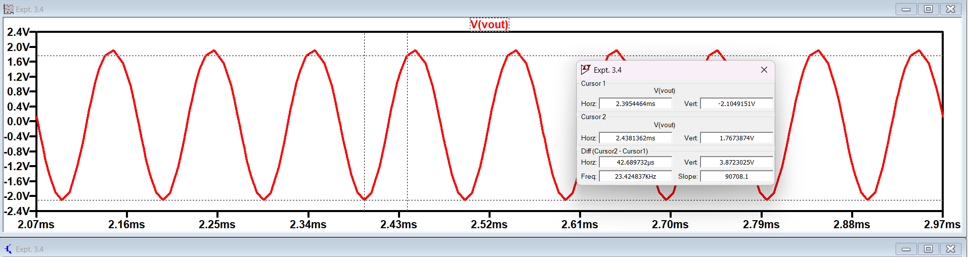
For C1 = C2 = 100pF
Ltspice Simulation
Vout(in mV) -->
Time(in ms) -->
Power-up Time = 42.689732us
A higher value of capacitance will result in a longer time constant, and a longer power-up time.

Slide 22
Impact of Coupling Capacitors
The coupling capacitors can impact the power-up time in the following ways:
Capacitance value: A higher value of capacitance will result in a longer time constant, and thus a longer power-up time. Conversely, a lower value of capacitance will result in a shorter time constant, and a shorter power-up time.
Charging and discharging: If the capacitance value is too high, the charging time will be longer, and it will take longer for the amplifier to stabilize. Similarly, during power-down, the coupling capacitors must discharge, and a high capacitance value will result in a longer discharge time.
Impedance matching: The impedance of the coupling capacitors must match the source and load impedances to ensure proper signal transfer. A mismatch in impedance can result in signal loss, distortion, or noise. The coupling capacitors should be chosen to have a low impedance at the frequency range of interest.

Slide 23
OBSERVATIONS
A higher value of capacitance will result in a longer power-up time and lower value of capacitance will result in shorter power up time.
In a self-biased common emitter amplifier, the emitter resistor (RE) is used to stabilize the operating point by providing negative feedback.
Transfer function for common emitter amplifier with self-biased configuration has 3 poles and 3 zeros.
The emitter part gives the dominant lower cut-off frequency among the three.

